Slide 1
MACHINE LEARNING USING PYTHON

Slide 2
Index
Introduction
History in brief
Relationship between AI ML and Deep Learning
Levels in AI
Types of ML algorithms
Some applications in real world
Future with ML
How to build a career in ML/AI

Slide 3
Key Terms
Dataset
A data set is a simple collection of data / information usually in some feasible storage format.
Structured Data
Structured data is the data that has predeﬁned structures.
Example: tables, spreadsheets, or relational databases.
Unstructured Data
Data with no predeﬁned structure, comes in any size or form, cannot be easily stored in tables.
Example: blobs of text, images, audio

Slide 4
Key Terms
Categorical Data
Data that can be labelled or divided into groups.
Example: hair colour
Data Formats
Data format is the format in which the data is stored.
Most Common Data Formats CSV, XML, SQL, JSON, Protocol Buﬀers.
Data Sources
We can find the required data for training through various ways.
Examples: Companies/Proprietary Data, APIs, Government, Academic, Web Scraping/Crawling

Slide 5
Key Terms
Training Data
Training data is the data used to ﬁt your models or the set used for learning
Validation data
Validation data is the data used to tune the parameters of a model
Test data
Test data is the data used to evaluate how good your model is. Ideally your model should never touch this data until ﬁnal testing/evaluation

Slide 6
Key Terms
Big Data
Massive datasets, or data that contains greater variety arriving in increasing volumes and with ever-higher velocity. Cannot ﬁt in the memory of a single machine
Algorithm
Algorithm in machine learning refers to a procedure or formula for solving a problem, based on conducting a sequence of specified actions
Model
Model in machine learning also called as machine learning model is a machine learning algorithm which has been implement though any one of the coding methodologies.

Slide 7
History of Machine Learning
Arthur Samuel, an American pioneer in the field of computer gaming and artificial intelligence, coined the term "Machine Learning" in 1959 while at IBM. As a scientific endeavour, machine learning grew out of the quest for artificial intelligence.
Machine learning, reorganized as a separate field, started to flourish in the 1990s. The field changed its goal from achieving artificial intelligence to tackling solvable problems of a practical nature.

Slide 8
Relationship between
AI, ML and Deep Learning
AI
ML
Deep Learning

Slide 9
What is Artificial Intelligence?

Slide 10
Artificial Intelligence
Computer science defines AI research as the study of "intelligent agents": any device that perceives its environment and takes actions that maximize its chance of successfully achieving its goals.
Generally, the term "artificial intelligence" is used to describe machines that mimic "cognitive" functions that humans associate with other human minds, such as "learning" and "problem solving".

Slide 11
Levels in Artificial Intelligence?

Slide 12
Levels of Artificial Intelligence:
ANI

Slide 13
Levels of Artificial Intelligence:
ANI
AGI

Slide 14
Levels of Artificial Intelligence:
ANI
AGI
ASI

Slide 15
What is Machine Learning?

Slide 16
Machine Learning
Machine Learning is a subset of artificial intelligence which focuses mainly on the learning from their experience and making predictions based on its experience.
It enables the computers or the machines to make data-driven decisions rather than being explicitly programmed for carrying out a certain task. These programs or algorithms are designed in a way that they learn and improve over time when are exposed to new data.

Slide 17
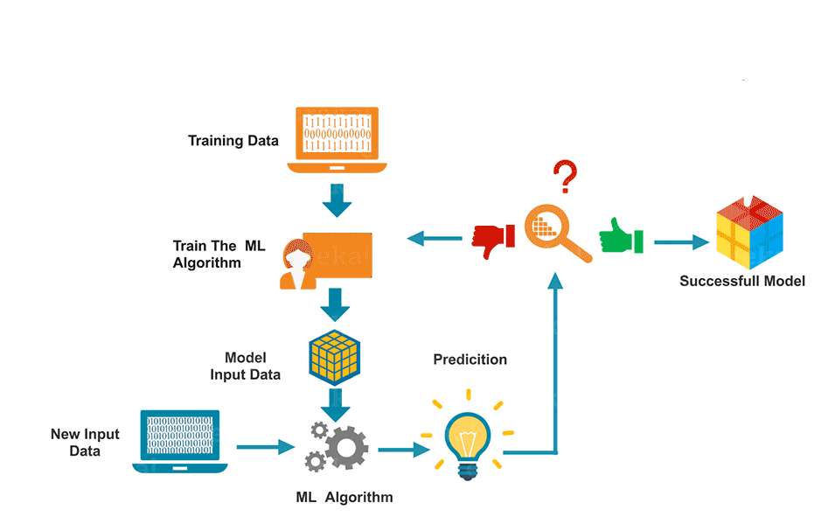
Machine Learning

Slide 18
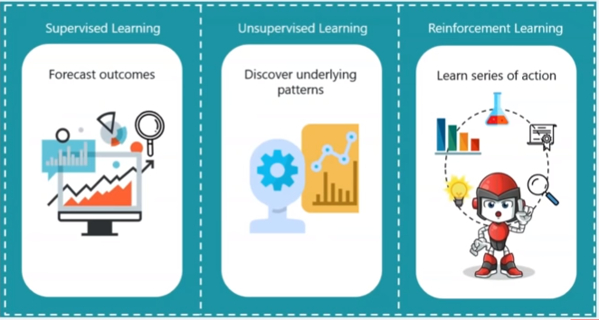
Machine Learning AIM:

Slide 19
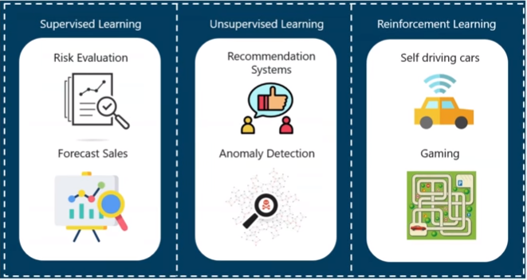
Machine Learning Applications:

Slide 20
Types of Machine Learning Algorithms

Slide 21
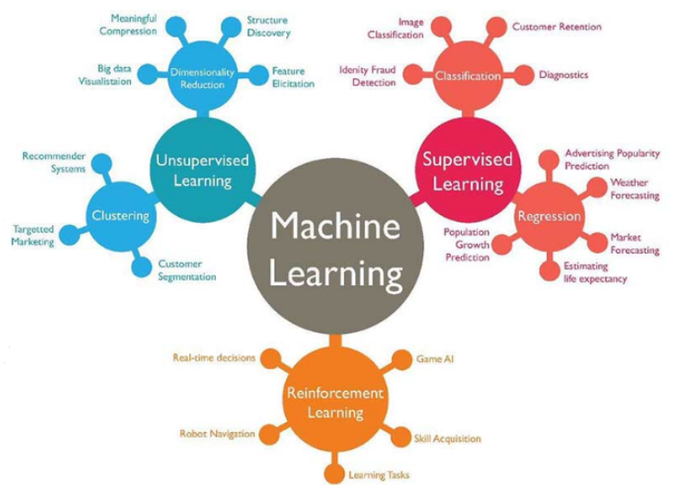
Types of Machine Learning Algorithms

Slide 22
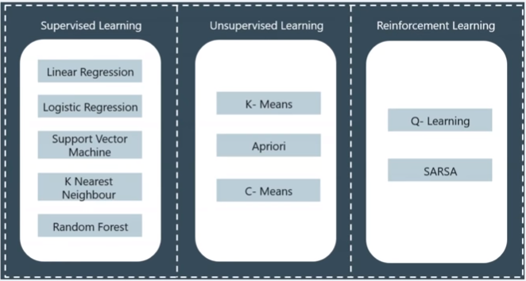
Machine Learning Algorithms:

Slide 23
What is Deep Learning?

Slide 24
Deep Learning
Deep learning (also known as deep structured learning or hierarchical learning) is part of a broader family of machine learning methods based on artificial neural networks. Learning can be supervised, semi-supervised or unsupervised.
Deep learning architectures such as deep neural networks, deep belief networks, recurrent neural networks and convolutional neural networks have been applied to fields including computer vision, speech recognition, natural language processing, audio recognition, social network filtering, machine translation etc, where they have produced results comparable to and in some cases superior to human experts.

Slide 25
Traditional Computing vs Machine Learning Systems

Slide 26
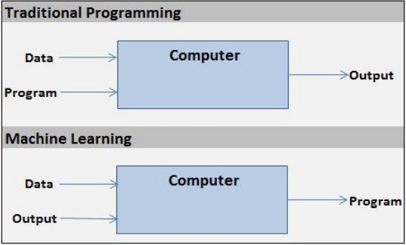
Traditional Computing vs Machine Learning System

Slide 27
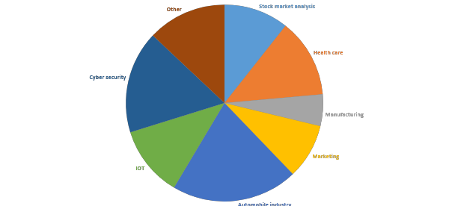
Use of AI/ML in today’s world

Slide 28
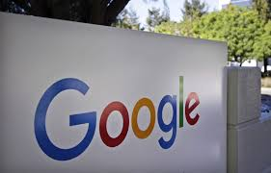
Use of AI/ML in today’s world
Google

Slide 29
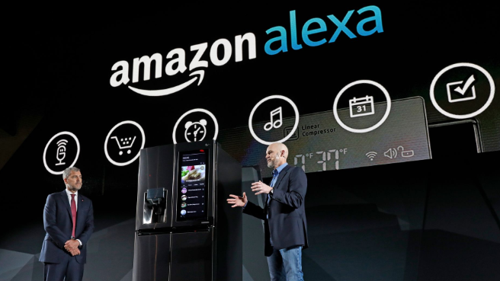
Use of AI/ML in today’s world
Google
Amazon

Slide 30

Use of AI/ML in today’s world
Google
Amazon
Facebook

Slide 31
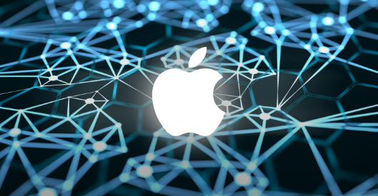
Use of AI/ML in today’s world
Google
Amazon
Facebook
Apple

Slide 32
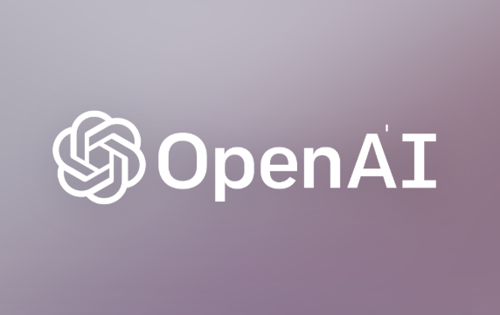
Use of AI/ML in today’s world
Google
Amazon
Facebook
Apple
Open AI

Slide 33

Use of AI/ML in today’s world
Google
Amazon
Facebook
Apple
Open AI
IBM

Slide 34
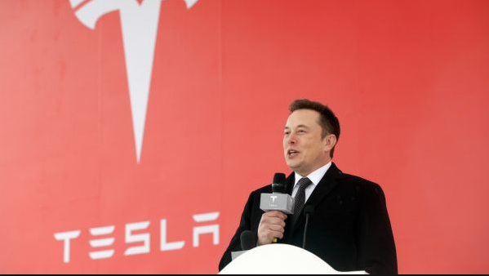
Use of AI/ML in today’s world
Google
Amazon
Facebook
Apple
Open AI
IBM
Tesla

Slide 35
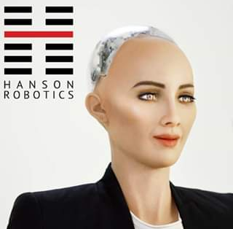
Use of AI/ML in today’s world
Google
Amazon
Facebook
Apple
Open AI
IBM
Tesla
Hanson Robotics

Slide 36
Future with AI/ML
Self driving cars
Improved medical care
Help in various research teams
Military services
Bomb squad replacement
Space exploration
etc

Slide 37
How to build a career in AI/ML ?
Choose a language of your comfort
Learn some basics of AI/ML through any online course
Join a community or form one
Compete on Kaggle making projects
Apply for internships/jobs

Slide 39
Basics of Python
For Machine Learning

Slide 40
Python (version-3)

Slide 41
Index
Types
Expressions and Variables
String operations
Input and output
Lists and Tuples
Dictionaries
Sets
Conditions and Branching
Loops
Functions
Objects and Classes
Reading Files with “OPEN”
Writing Files with “OPEN”
Loading data with PANDAS
One Dimensional NUMPY
Two Dimensional NUMPY

Slide 42
PYTHON TYPES

Slide 43
Python Types
11

Slide 44
Python Types
11
561.73

Slide 45
Python Types
11
561.73
“Hello!”

Slide 46
Python Types
Type function:
type(Expression)→ Datatype

Slide 47
Python Types
Type function:
type(11) → Integer
type(561.73) → Float
type(“Hello!”) → String

Slide 48
Type Casting:
Type casting is a process of converting one data type into another data type.
Python Types

Slide 49
Type Casting : Examples
float(11) → 11.0
int(561.23) → 561
int(“Hello!”) → Error
int(“15”) → 15
str(1.25) → “1.25”
Python Types

Slide 50
Python Types
Type Boolean :
True
False

Slide 51
Python Types
Type Boolean :
type(True) → bool
type(False) → bool
int(True) → 1
bool(1) → True

Slide 52
PYTHON EXPRESSIONS AND VARIABLES

Slide 53
Expressions and
Variables
Expressions :
Expressions describe a type of operations that computers perform.
Expressions are operations the python performs, for example, basic arithmetic operations like adding multiple numbers.

Slide 54
Expressions and
Variables
Expressions :
Example-1 :
1+2+3+4-5+6+7+8+9+10 = 45
Here,
1 to 10 → Operands
+, - → Operators

Slide 55
Expressions and
Variables
Expressions :
Example-2:
10*6 = 60
Example-3:
20/4 = 5.0 → This is regular division
20//4 = 5 → This is called integer division

Slide 56
Expressions and
Variables
Variables :
Variables can be used to store values and to perform operations.
In python we need not initialize variables with their datatypes and is automatically type casted when required.

Slide 57
Expressions and
Variables
Variables :
Example-1:
A = 5
B = 20
C = A*B-50
Value of C → 50

Slide 58
Expressions and
Variables
Variables :
Example-2:
A = 5+20+25
B = A-15
Value of A → 50
Value of B → 35

Slide 59
Expressions and
Variables
Variables :
Example-3:
A = 25
A = A*4
Value of A → 100

Slide 60
PYTHON STRINGS

Slide 61
Strings
In Python, a string is a sequence of characters.
A string is contained within two quotes. We can also use single quotes.
A string can be spaces or digits.
A string can also be special characters.
We can bind or assign a string to another variable.
It is helpful to think of a string as an ordered sequence.

Slide 62
Strings
Example:
String1 = “Machine Learning”
or
‘Machine Learning’

Slide 63
Strings
Example:
String1 = “Machine Learning”
or
‘Machine Learning’
+ 0 1 2 3 4 5 6 7 8 9 10 11 12 13 14 15
- -16 -15 -14 -13 -12 -11 -10 -9 -8 -7 -6 -5 -4 -3 -2 -1
M | a | c | h | i | n | e |  | L | e | a | r | n | i | n | g

Slide 64
Strings
Example:
0 1 2 3 4 5 6 7 8 9 10 11 12 13 14 15
Now,
String1[0] → “M”
String1[8] → “L”
String1[-13] → “h”
M | a | c | h | i | n | e |  | L | e | a | r | n | i | n | g

Slide 65
Strings
Example:
0 1 2 3 4 5 6 7 8 9 10 11 12 13 14 15
String slicing
String1[0:4] → “Mach”
String1[8:12] → “Lear”
String stride
String1[::2] → “McieLann”
String1[0:9:2] → “McieL”
M | a | c | h | i | n | e |  | L | e | a | r | n | i | n | g

Slide 66
Strings
Example:
0 1 2 3 4 5 6 7 8 9 10 11 12 13 14 15
String Length function
len(“String1”) → 15
String manipulations
String2 = String1 + “with Python”
String2 → “Machine Learning with Python”
String3 = 2*String1
String3 → “Machine Learning Machine Learning”
M | a | c | h | i | n | e |  | L | e | a | r | n | i | n | g

Slide 67
Strings
Example:
0 1 2 3 4 5 6 7 8 9 10 11 12 13 14 15
Strings are immutable
We cannot change the value of a string.
String1[0] = “F”
M | a | c | h | i | n | e |  | L | e | a | r | n | i | n | g

Slide 68
Strings
Example:
0 1 2 3 4 5 6 7 8 9 10 11 12 13 14 15
Escape sequences:
\n → For a new line
\t → For a new tab space
M | a | c | h | i | n | e |  | L | e | a | r | n | i | n | g

Slide 69
Strings
Example:
0 1 2 3 4 5 6 7 8 9 10 11 12 13 14 15
Escape sequences:
Examples:
print(“Machine \n Learning”)
Output → Machine
Learning
print(“Machine \t Learning”)
Output → Machine Learning
M | a | c | h | i | n | e |  | L | e | a | r | n | i | n | g

Slide 70
String Methods:
Python has a set of built-in methods that you can use on strings.
All string methods returns new values.
They do not change the original string.
Let’s suppose two strings ‘A’ and ‘B’
A → Method → B
Strings

Slide 71
String Methods:
Example - 1:
A = “Machine Learning with Python”
Let’s try method “upper”
B = A.upper()
print(B)
Output
MACHINE LEARNING WITH PYTHON
Strings

Slide 72
String Methods:
Example - 2:
A = “Machine Learning with Python”
Let’s try method “replace”
B =A.replace(‘Python’, ‘R’)
print(B)
Output
MACHINE LEARNING WITH R
Strings

Slide 73
Taking inputs
We can use “input()” to take inputs.
But in python 3, default type of the value taken as input is string.
So if we want to take any other data type inputs, we must specify it.
And for outputs we can simply use print statement.
Inputs
And
Outputs

Slide 74
Example:
String_input = input()
print(String_input)
Integer_input = int(input())
print(Integer_input)
print(Integer_input + 1)
Float_input = float(input())
print(Float_input)
Inputs
And
Outputs

Slide 75
PYTHON Lists and Tuples

Slide 76
Tuples:
In python tuples are an ordered sequences.
Tuples are immutable.
They are written as comma-separated values.
Tuples can be nested
Example:
Exampletuple=(1,9,6,8)
Python
Lists and Tuples

Slide 77
Tuples:
All the three data types in python can be contained in tuples.
Example
tuple2=(‘ML’, 1, 95.68)
Type of any tuple is the same
type(tuple2) → tuple
Python
Lists and Tuples

Slide 78
Lists:
In python lists are an ordered sequences and is represented in square brackets.
Lists are very similar to tuples
Only difference between lists and tuples is that lists are mutable
Example:
L=[“Machine Learning”, 10 ,5.2]
Python
Lists and Tuples

Slide 79
Lists:
We can nest lists into lists.
We can also nest tuples into lists
Example:
L=[“Machine Learning”, [10 ,5.2], (“A”,1)]
Python
Lists and Tuples

Slide 80
PYTHON Dictionaries

Slide 81
Dictionaries:
Dictionaries are a type of collection in Python.
These are like addresses.
A dictionary has keys and values.
The keys are like addresses but they don't have to be integers and are usually characters.
Python
Dictionaries

Slide 82
Dictionaries:
The values are similar to the element in a list and contain information.
To create a dictionary, we use curly brackets.
Keys must be immutable and unique.
Each key is followed by a value separated by a colon.
Python
Dictionaries

Slide 83
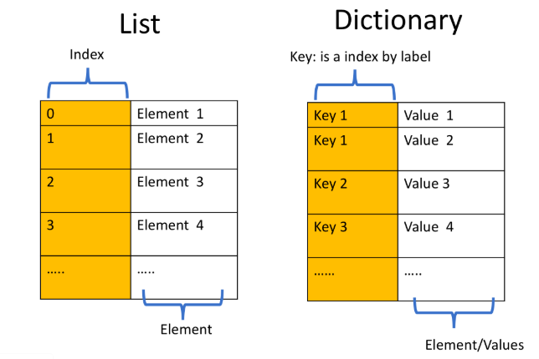
Dictionaries:
Python
Dictionaries

Slide 84
Dictionaries:
The values can be immutable, mutable, and duplicates.
Each key and value pair is separated by a comma.
Python
Dictionaries

Slide 85
PYTHON Sets

Slide 86
Sets:
Sets are a type of collection of elements.
Unlike lists and tuples, these are unordered.
These only have unique elements.
Sets are represented using curly brackets.
Python
Sets

Slide 87
Sets:
Example:
Set1={“A”, “AI”, “ML”, “A”, “B”}
Set1 is stored as
Set1 →{“A”, “AI”, “ML”, “B”}
Python
Sets

Slide 88
Sets:
We can also convert a list into a set. This process is called type casting.
Using:
set_list=set(nameofthelist)
Python
Sets

Slide 89
Sets:
Set operations:
Add
Remove
In – True/False
Union
Intersection
Python
Sets

Slide 90
PYTHON Conditions and Branching

Slide 91
Conditions and Branching
Conditions are branching :
If
Elif
else

Slide 92
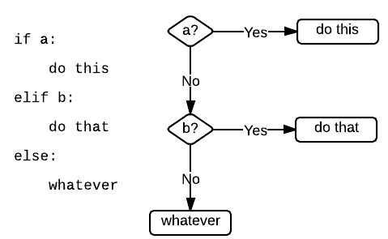
Conditions are branching :
Conditions and Branching

Slide 93
PYTHON Loops

Slide 94
Loops
Loops:
For
While

Slide 95
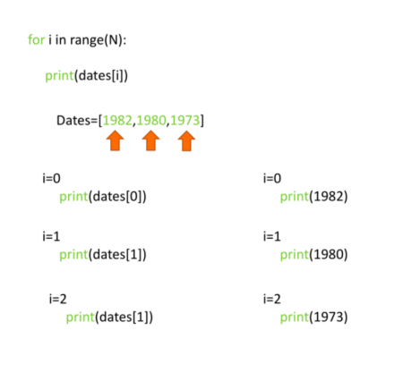
Loops
Loops: for

Slide 96
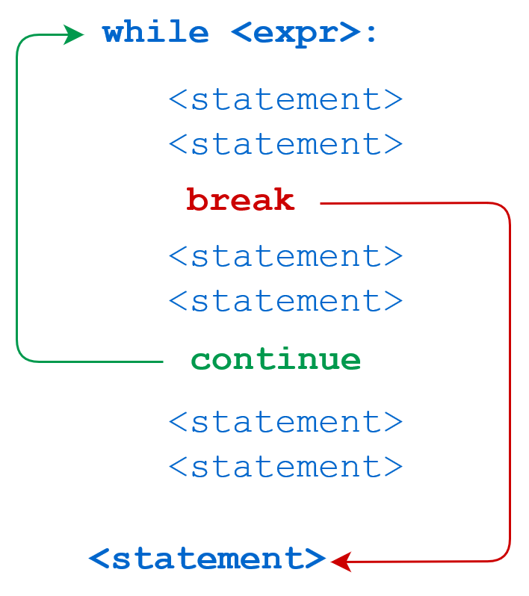
Loops
Loops: while

Slide 97
PYTHON Functions

Slide 98
Functions
Functions are blocks of code which can be used on a call.
Python consists of many inbuilt functions.
Functions can also be defined by the user

Slide 99
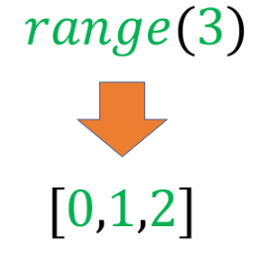
Functions
Example:
Range function-

Slide 100
PYTHON Objects and Classes

Slide 101
Objects and Classes
Objects in programming are like objects in real life.
Like life, there are different classes of objects.
Instances of a Class: Objects and Attributes
An instance of an object is the realisation of a class

